Slide 1


CSB4301 - WEB TECHNOLOGY
B.Tech – V Semester
Class 8
Dr. P. N Renjith, Dr. Muthukumaran, Mr. Balasubrmani S
School of Computing Sciences,
Department of Computer Science and Engineering

Slide 2
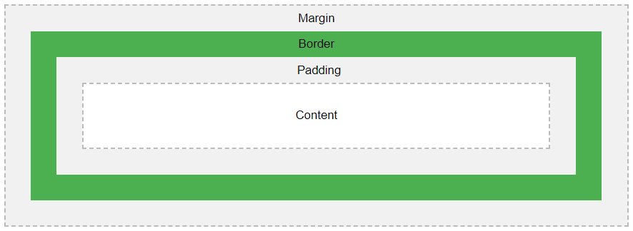
Lecture 7 - CSS Box Model
All HTML elements can be considered as boxes. In CSS, the term "box model" is used when talking about design and layout.
The CSS box model is essentially a box that wraps around every HTML element. It consists of: margins, borders, padding, and the actual content. The image below illustrates the box model:

Slide 3
CSS Box Model
Explanation of the different parts:
Content - The content of the box, where text and images appear
Padding - Clears an area around the content. The padding is transparent
Border - A border that goes around the padding and content
Margin - Clears an area outside the border. The margin is transparent
The box model allows us to add a border around elements, and to define space between elements.

Slide 4
Definition and Usage
The <div> tag defines a division or a section in an HTML document.
The <div> tag is used as a container for HTML elements - which is then styled with CSS or manipulated with JavaScript.
The <div> tag is easily styled by using the class or id attribute.
Any sort of content can be put inside the <div> tag!

Slide 5
CSS Box Model
div { width: 300px; border: 15px solid green; padding: 50px; margin: 20px; }

Slide 6
CSS Box Model
<!DOCTYPE html>
<html>
<head>
<style>
.myDiv {
border: 5px outset red;
background-color: lightblue;
text-align: center;
}
</style>
</head>
<body>
<h1>The div element</h1>
<div class="myDiv">
<h2>This is a heading in a div element</h2>
<p>This is some text in a div element.</p>
</div>
<p>This is some text outside the div element.</p>
</body>
</html>

Slide 7
CSS Pseudo-classes
What are Pseudo-classes?
A pseudo-class is used to define a special state of an element.
For example, it can be used to:
Style an element when a user use mouse over it
Style visited and unvisited links differently
Style an element when it gets focus.
Syntax
The syntax of pseudo-classes:
selector: pseudo-class { property: value; }

Slide 8
Anchor Pseudo-classes
Links can be displayed in different ways:
Example
/* unvisited link */ a:link { color: #FF0000; } /* visited link */ a:visited { color: #00FF00; } /* mouse over link */ a:hover { color: #FF00FF; } /* selected link */ a:active { color: #0000FF; }

Slide 9
<!DOCTYPE html>
<html>
<head>
<style>
/* unvisited link */
a:link {
color: black;
}
/* visited link */
a:visited {
color: green;
}
/* mouse over link */
a:hover {
color: hotpink;
}
/* selected link */
a:active {
color: blue;
}
</style>
</head>
<body>
<h2>CSS Links</h2>
<p><b><a href="myfirst.html" target="_blank">This is a link</a></b></p>
</body>
</html>

Slide 10
CSS Pseudo-classes
Note: a:hover MUST come after a:link and a:visited in the CSS definition in order to be effective!
a:active MUST come after a:hover in the CSS definition in order to be effective!
Pseudo-class names are not case-sensitive.
Pseudo-classes can be combined with CSS classes:
When you hover over the link in the example, it will change color:
Example
a.highlight:hover { color: #ff0000; }

Slide 11
<!DOCTYPE html>
<html>
<head>
<style>
a.highlight:hover {
color: #ff0000;
}
</style>
</head>
<body>
<h2>Pseudo-classes and CSS Classes</h2>
<p>When you hover over the first link below, it will change color:</p>
<p><a class="highlight" href=“myfirst.html">CSS Syntax</a></p>
<p><a href=“myfirst.html">CSS Tutorial</a></p>
</body>
</html>

Slide 12
CSS Pseudo-classes
<html>
<head>
<style>
div {
background-color: green;
color: white;
padding: 25px;
text-align: center;
}
div:hover {
background-color: blue;
}
</style>
</head>
<body>
<p>Mouse over the div element below to change its background color:</p>
<div>Mouse Over Me</div>
</body>
</html>

Slide 13
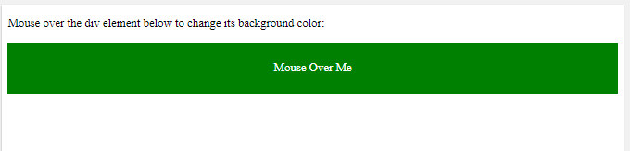
CSS Pseudo-classes.. (Cont…)

Slide 14
CSS - The :first-child Pseudo-class
The :first-child pseudo-class matches a specified element that is the first child of another element.
Match the first <p> element
In the following example, the selector matches any <p> element that is the first child of any element:
Example
p:first-child { color: blue; }

Slide 15
CSS - The :first-child Pseudo-class
<!DOCTYPE html>
<html>
<head>
<style>
p:first-child {
color: blue;
}
</style>
</head>
<body>
<p>This is some text.</p>
<p>This is some text.</p>
<p><b>Note:</b> For :first-child to work in IE8 and earlier, a DOCTYPE must be declared.</p>
</body>
</html>

Slide 16

CSS - The :first-child Pseudo-class
OUTPUT

Slide 17
i:first-child Pseudo-class
Match the first <i> element in all <p> elements
In the following example, the selector matches the first <i> element in all <p> elements:
Example
p i:first-child { color: blue; }

Slide 18
i:first-child Pseudo-class
<!DOCTYPE html>
<html>
<head>
<style>
p i:first-child {
color: blue;
}
</style>
</head>
<body>
<p>I am a <i>strong</i> person. I am a <i>strong</i> person.</p>
<p>I am a <i>strong</i> person. I am a <i>strong</i> person.</p>
<p><b>Note:</b> For :first-child to work in IE8 and earlier, a DOCTYPE must be declared.</p>
</body>
</html>

Slide 19
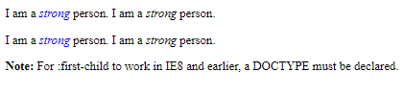
i:first-child Pseudo-class
Output

Slide 20
CSS - The :lang Pseudo-class
The :lang pseudo-class allows you to define special rules for different languages.
In the example below, :lang defines the quotation marks for <q> elements with lang="no":
Example
<html> <head> <style> q:lang(no) { quotes: "~" "~"; } </style> </head> <body> <p>Some text <q lang="no">A quote in a paragraph</q> Some text.</p> </body> </html>

Slide 21
What are Pseudo-Elements?
A CSS pseudo-element is used to style specified parts of an element.
For example, it can be used to:
Style the first letter, or line, of an element
Insert content before, or after, the content of an element.
The syntax of pseudo-elements:
selector::pseudo-element
{ property: value; }

Slide 22
What are Pseudo-Elements?
<!DOCTYPE html>
<html>
<head>
<style>
p::first-line {
color: #ff0000;
font-variant: small-caps;
}
</style>
</head>

Slide 23
What are Pseudo-Elements?
<body>
<p>You can use the ::first-line pseudo-element to add a special effect to the first line of a text. Some more text. And even more, and more, and more, and more, and more, and more, and more, and more, and more, and more, and more, and more.</p>
</body>
</html>

Slide 24
Notice the double colon notation
Notice the double colon notation - ::first-line versus :first-line The double colon replaced the single-colon notation for pseudo-elements in CSS3. This was an attempt from W3C to distinguish between pseudo-classes and pseudo-elements.

Slide 25
The ::first-letter Pseudo-element
The ::first-letter pseudo-element is used to add a special style to the first letter of a text.
The following example formats the first letter of the text in all <p> elements:
p::first-letter { color: #ff0000; font-size: xx-large; }

Slide 26
The ::first-letter Pseudo-element
<!DOCTYPE html> <html>
<head>
<style>
p::first-letter {
color: #ff0000;
font-size: xx-large;
}
</style>
</head>
<body>
<p>You can use the ::first-letter pseudo-element to add a special effect to the first character of a text!</p>
</body>
</html>

Slide 27
The ::first-letter Pseudo-element
<!DOCTYPE html> <html>
<head>
<style>
p::first-letter {
color: #ff0000;
font-size: xx-large;
}
</style>
</head>
<body>
<p>You can use the ::first-letter pseudo-element to add a special effect to the first character of a text!</p>
</body>
</html>

Slide 28
CSS - The ::before Pseudo-element
The ::before pseudo-element can be used to insert some content before the content of an element.
The following example inserts an image before the content of each <h1> element:
Example
h1::before { content: url(smiley.gif); }

Slide 29
CSS - The ::after Pseudo-element
The ::after pseudo-element can be used to insert some content after the content of an element.
The following example inserts an image after the content of each <h1> element:
Example
h1::after { content: url(smiley.gif); }

Slide 30
Set text color to red, for the first line of the <p> element.
<!DOCTYPE html>
<html>
<head>
<style>
</style>
</head>
<body>
<p>In my younger and more vulnerable years my father gave me some advice that I've been turning over in my mind ever since. 'Whenever you feel like criticizing anyone,' he told me, 'just remember that all the people in this world haven't had the advantages that you've had.'</p>
</body>
</html>
<style>
p::first-line {
color: red;
}
</style>

Slide 31
Set text color to "red", and the text size to "xx-large", for the first letter of the <p> element.
<!DOCTYPE html>
<html>
<head>
<style>
</style>
</head>
<body>
<p>In my younger and more vulnerable years my father gave me some advice that I've been turning over in my mind ever since. 'Whenever you feel like criticizing anyone,' he told me, 'just remember that all the people in this world haven't had the advantages that you've had.'</p>
</body>
</html>
<style>
p::first-letter {
color: red;
font-size: xx-large;
}
</style>

